Slide 1



Automated Labor
Prajith K, Kesavaram V, Nithin Iswar P, Gopinathan K

Slide 2


CENSUS
A recent estimate shows that , around 5% of total shipping costs are lost to internal shipping errors every year. For businesses with tight margins, this can have a devastating impact. The cost of shipping and picking errors is, therefore, not to be ignored.

Slide 3
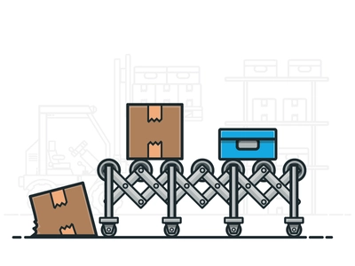
Currently industries use conveyer belts to ship goods within the plant
When it comes to conveyor belts, too little or too much tension can cause a direct impact to the performance of your operations. If your head pulley wears down, there is no longer an adequate amount of traction to grip the belt causing excessive stretching, audible squeals, and conveyance slippage to occur.
Shipping goods to complicated locations within the plant using conveyer belts is complex
Time-consuming maintenance is often needed to remove build up

Slide 4
How can we substitute these conveyer belts?

Slide 5
We the Students of Sri Venkateswara College of Engineering have resulted in the creation of an automated labor that works for the mankind by replacing the conveyer belts to move a specified object in a specified path, to follow a specific object and monitor it. All these mentioned action can be controlled with an app, which connects with the automated labor via Bluetooth. The AL doesn’t involve any human supervision, does not occupy more space. Implementation of AL in complicated areas is simpler compared to the conveyer belts

Slide 6

02
How AL works?

Slide 7
AL has four modes
1.)Path following mode
2.)Object avoidance in path following mode
3.)Vacuum cleaner mode
4.)Object Following mode

Slide 8
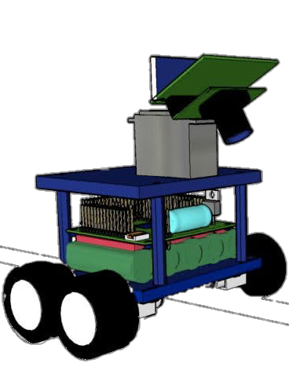
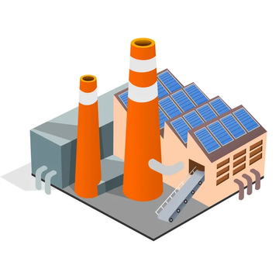
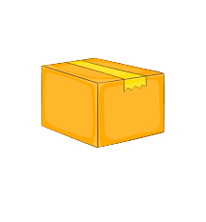


PATH FOLLOWING MODE

Slide 9
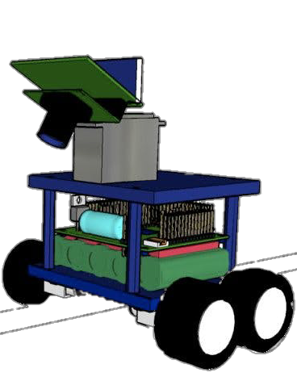
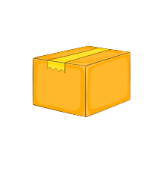

Slide 13
OBJECT AVOIDANCE IN PATH FOLLOWING MODE

Slide 16
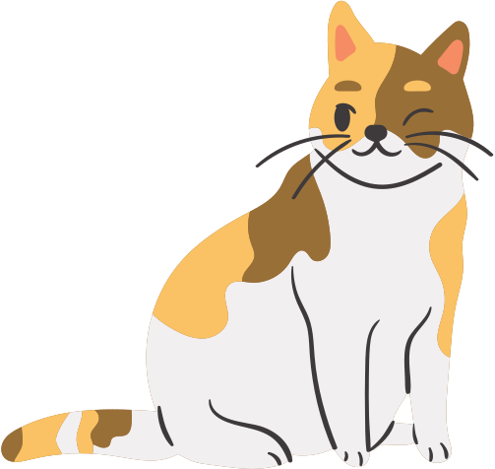

Slide 17


Slide 22
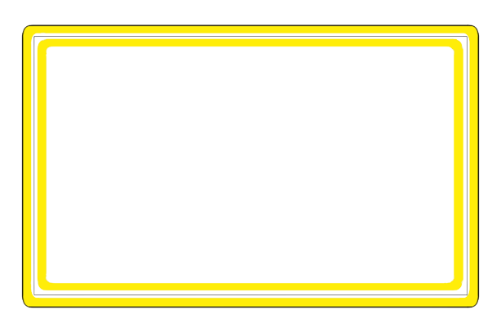
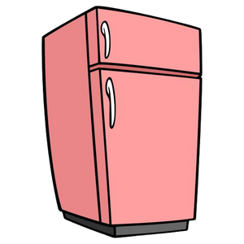



Vacuum cleaner mode

Slide 27


Slide 33





OBJECT FOLLOWING MODE

Slide 40
OUR
PROTOTYE!

Slide 41
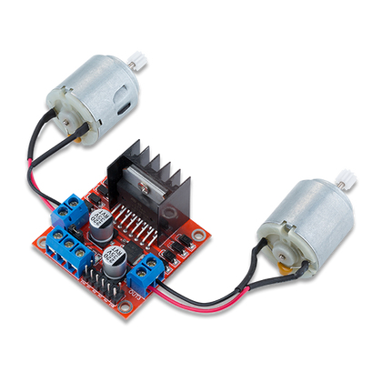
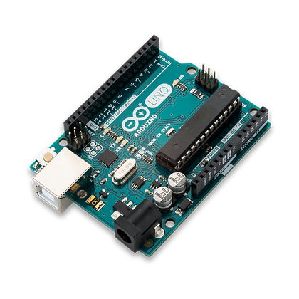
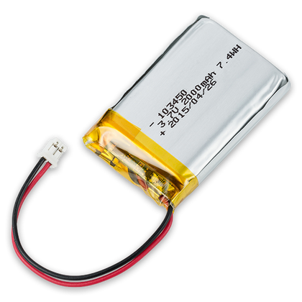
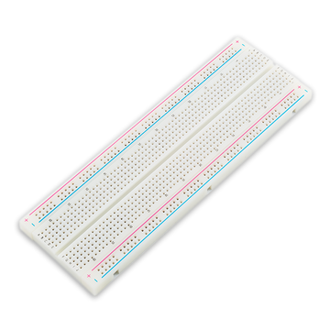
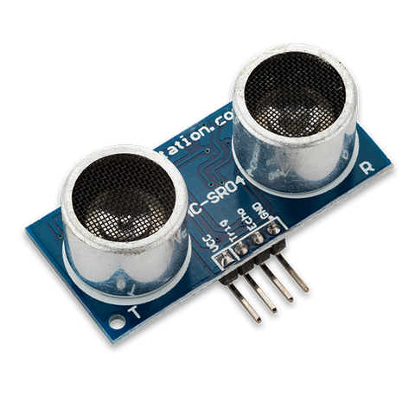
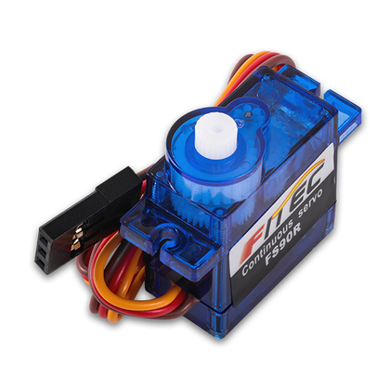
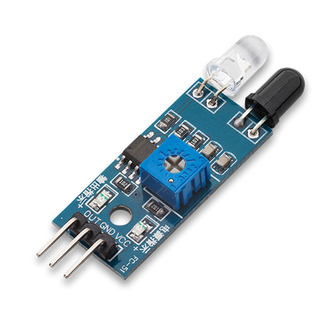
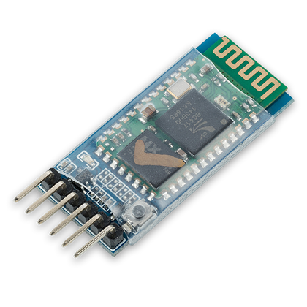
COMPONENTS USED

Slide 42
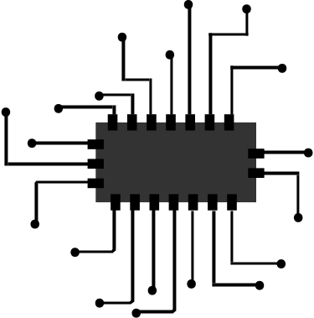

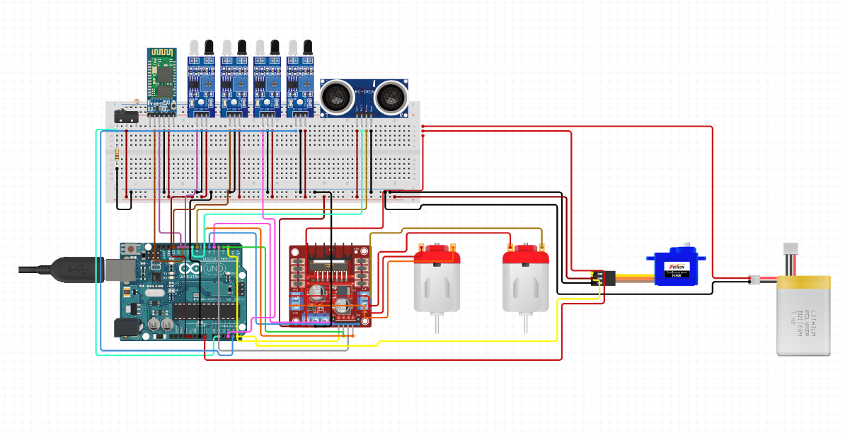
CIRCUIT DIAGRAM

Slide 43
USER INTERFACE OF AL APP

Slide 44
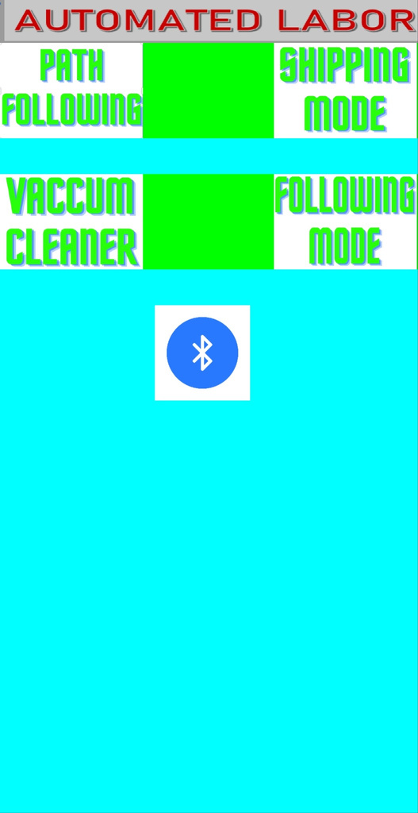
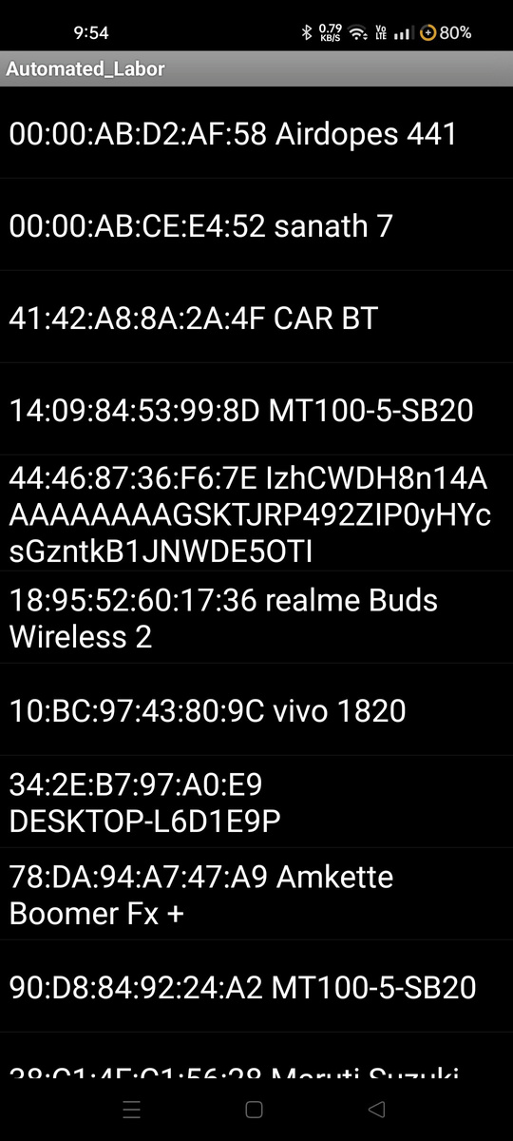


CONNECTING TO AL VIA

Slide 45
FUTURE IMPLEMENTATION
Implementaion of Machine Learning to Identify dirt in vaccum cleaner mode
Implementaion of Lidar sensors to map the entire area of the given location
Implementaion of Cloud services to store maps of differnt location
Implementation of reinforcement learning

Slide 46
THANK
YOU

